Slide 1
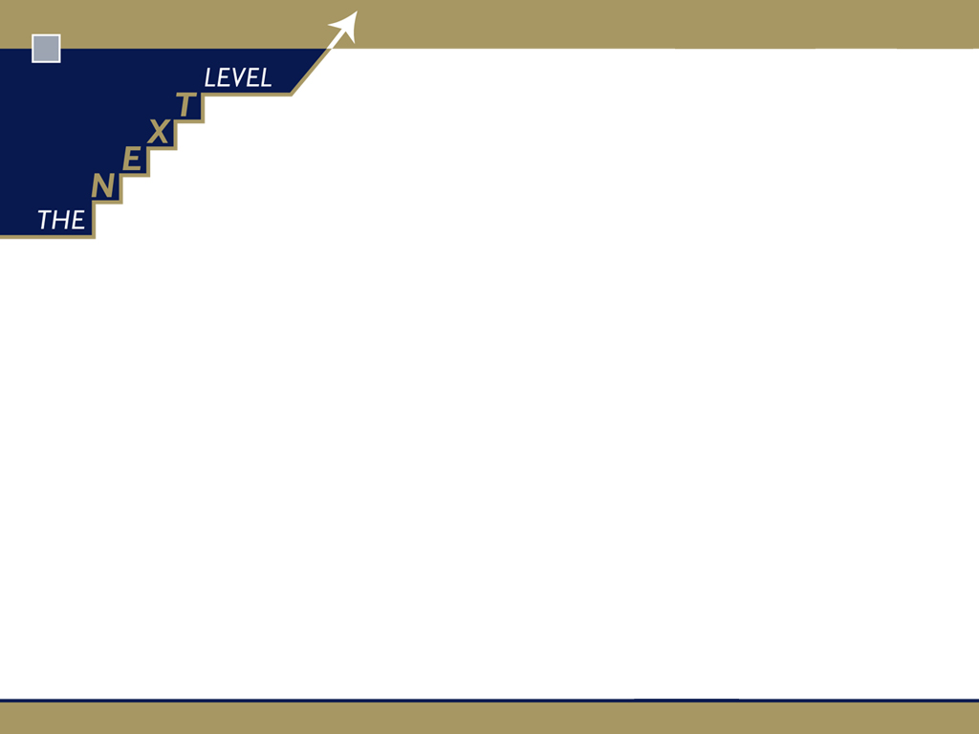
Generate and gather the data
The balance between purity and practicality
Glenn Guilfoyle

Slide 2
The Next Level …. What we do and how we do it
Specialise in deploying proprietary Sales System to any B2B organisation
  model,
  map,
  design,
  plan,
  measure maximum sales team productivity and RoI
Work collaboratively, transferring tools, skills and knowledge to our clients

Slide 3
The Next Level Sales System
Sales team optimisation and Sales exec effectiveness system
  tailored for any business-to-business sales organisation
End-to-end suite of modellers, designers, mappers
  review, challenge, renew sales team utilisation, strategy, benchmarks
    optimise sales process, system, teams performance

Slide 4
What is Sales team optimisation?
Analytics that align Sales team design and process to customer base and prospect pool to ensure ….
  Maximum productivity and RoI from resource available
Science of engineering a sales team to a tailored system …
  Mobilises resource to best utilisation for maximum realisation

Slide 5
40,000 B2B Sales organisations are sub-optimised
At least “a handful of road warriors”
Large, heterogeneous collection of customers and prospects
Repeat visits to align with repeat order consumable products or services
Customer has switchable supplier choice

Slide 6
What is Sales team optimisation?
Right person
Right time
Right frequency
Right reason
Right value
Right partnership framework

Slide 7
Generate and gather the data

Slide 8
Assess current productivity and return

Slide 9
Eight productivity “levers” to increase RoI

Slide 10
Current daily visit activity rate to low side of B2B cross industry norms

Slide 11
Visit : drive time ratio ripe for improvement

Slide 12
Current cost of visit higher than B2B cross industry norms

Slide 13
Productivity gains pitted against increased RoI expectations

Slide 14
StO scenario priorities

Slide 15
Renew sales strategy

Slide 16
Value Chain structure model….. for each end user – end product
Buyers
Non-buyers
End users
Wholesalers
Value adders
Distributors
B2B
consumers
Defined in terms
of where “focus player’s”
product/service is consumed
(in its visible form) or finally
changes ownership
Suppliers
Makers
Installers
Value
adders
B2P
consumers
Specifiers
Resellers/ brokers
Retailers

Slide 17
Chains and channels environment

Slide 18
Sales team alignment in the chains and channels environment

Slide 19
Generate and gather the data

Slide 20
Six tranches of data
CV
PV

Slide 21
Current Value
Value of all products/services purchased by each customer
  direct
  indirect
Ideally calculated and expressed in terms of customer margin contribution
Currency of CV needs to be determined in terms of finance system practicalities

Slide 22
Current Value
Method and period of data collection
Snapshot – does not attempt to account for growth/trend at point in time
Data should be attained for every customer over defined period
Analytics of listing ALL customers top to bottom provides useful insight to spread of business

Slide 23
CV shape-of-curve

Slide 24
CV shape-of-curve

Slide 25
Current Value … the typical realities and pitfalls
If you trade directly
If you trade indirectly
If you trade conditionally

Slide 26
Current Value … the typical realities and pitfalls
If you trade directly
If you trade indirectly
If you trade conditionally
If you can access “line of sight” data

Slide 27
Potential Value
Value of all products/services in categories in which organisation competes
  direct
  indirect
PV data is ideally calculated and expressed in same “currency” as CV data
Method and period of data collection should then be set and implemented
  PV collection on all customers
  PV collection on all prospects

Slide 28
Potential Value
Best selection of PV currency is nearly always a trade-off
  Readily available vs needs to be generated
  Sales team involvement vs industry data
  Proxy vs “real” data
Snapshot – does not attempt to account for growth/trend at point in time
PV SoC

Slide 29
PV shape-of-curve

Slide 30
PV shape-of-curve

Slide 31
Potential Value … typical realities and pitfalls will be just as relevant
If you trade directly
If you trade indirectly
If you trade conditionally

Slide 32
Potential Value … the typical realities and pitfalls
If you can access industry/channel data
  At individual customer/prospect level
    “gold”
If you have the customer base and prospect pool profiled
  Design a “weight and rate” proxy model
    “silver”
If you have market size data
  Create assumed shape-of-curve and brief sales team on “forced distribution”
    “bronze”

Slide 33
The roadmap

Slide 34
These principles apply to the CV problem when you don’t have line of sight
If you can access industry/channel data
  At individual customer/prospect level
    “gold”
If you have the customer base and prospect pool profiled
  Design a “weight and rate” proxy model
    “silver”
If you have market size data
  Create assumed shape-of-curve and brief sales team on “forced distribution”
    “bronze”

Slide 35
CV and/or PV challenged? … there is always a way …

Slide 36
there is always a way … it is never perfect … journey of continuous improvement

Slide 37
Six tranches of data
CV
  Direct and indirect
PV
  Direct and indirect
Cost-of-sale; cost-to-serve
Basic internal sales team productivity and return data
Basic external competitor sales team and market data
Sales Exec activity:time allocation

Slide 38
Cost of sales and cost to serve
Allocate all direct costs to support sales people managing customer base
Sales support
  Cost to company of sales person paid and fully equipped
  Sales management
  Internal sales/telesales
Service support
  Customer Service/Call centre
  Quotation processing
  Technical support
  Any other functionary that directly serves same customer base

Slide 39
Cost of visit reality can be used to recalibrate

Slide 40
Internal sales team productivity & return data

Slide 41
External market & competitor data

Slide 42
Six tranches of data
CV
  Direct and indirect
PV
  Direct and indirect
Cost-of-sale; cost-to-serve
Basic internal sales team productivity and return data
Basic external competitor sales team and market data
Sales Exec activity:time allocation

Slide 43
Time : activity data

Slide 44
Office time higher than expected

Slide 45
F2F time less than expected … Solo office time more than expected

Slide 46
Responsive and reactive visit time higher than expected

Slide 47
Value neutral and value destroying office time higher than expected

Slide 48
Visit : drive time ratio – opportunity for improvement

Slide 49
Sales and Service cycles
Service Cycle
Sales Cycle
Plan, execute product – current service order/delivery needs
Grow
Preserve
Relationship
Ensure
needs received to customer satisfaction
Notes:
49

Slide 50
Data sourcing
CV
PV
CoS/CtS
Internal StP & R
External market data
S/E time:allocation data
Finance system -> channel partners -> proxy scores
CRM -> Industry databases -> proxy scores
Finance system
S & M Management
S & M Management
Sales Execs 1 hr on-line survey

Slide 51
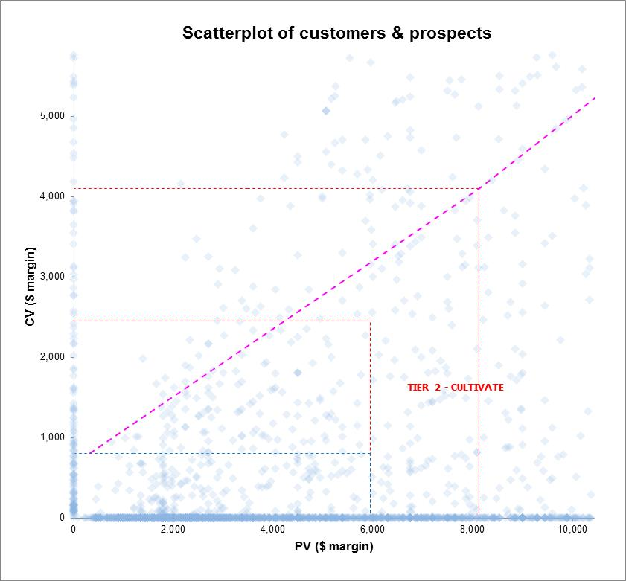
The CV, PV, SoW, CoV inputs create classification scatterplot

Slide 52
Upgrade selling systems

