Slide 1
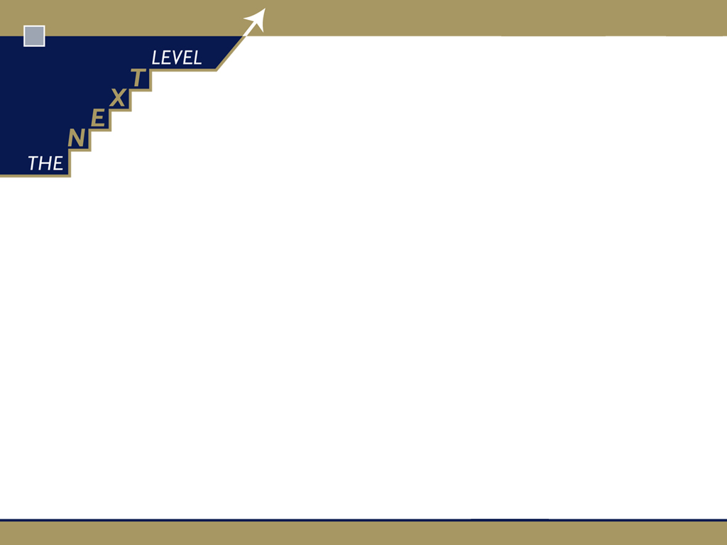
The strategic framework for your annual sales team optimisation….
How to prosecute your go-to-market and sales-team-alignment strategies
Glenn Guilfoyle

Slide 2
The Next Level Sales System foundations…
25 years – 100 organisations – 15 sectors

Slide 3
The Next Level …. What we do and how we do it

Slide 4
The Next Level …. What we do and how we do it
Specialise in deploying proprietary Sales System to any B2B organisation
  model,
  map,
  design,
  plan,
  measure maximum sales team productivity and RoI
Work collaboratively, transferring tools, skills, knowledge

Slide 5
Sub-optimisation – the “unrecognised problem”
Square pegs in round holes
Insufficient arms and legs
Inadequate skills, knowledge

Slide 6
Sub-optimisation – the “hidden problem”
Sales Execs entrusted with too much bandwidth
Lack a dynamic sales system to operate within
  Regardless of current members; personalities

Slide 7
Systemic approach to maximising RoI from mobilising the Sales team
Scientific, data driven system dynamically determines who, when, what, why … for whole team
Each Sales Exec’s bandwidth is focussed to how they conduct themself during each “hour of truth”

Slide 8
What is Sales team optimisation?
Analytics that align Sales team design and process to customer base and prospect pool to ensure ….
  Maximum productivity and RoI from resource available
Science of engineering a sales team to a tailored system …
  Mobilises resource to best utilisation for maximum realisation

Slide 9
What is Sales team optimisation?
Right person
Right time
Right frequency
Right reason
Right value
Right partnership framework

Slide 10
Problem solved
Failure to deliver maximum revenue/margin
From under-productivity
Due to lack of sales system

Slide 11
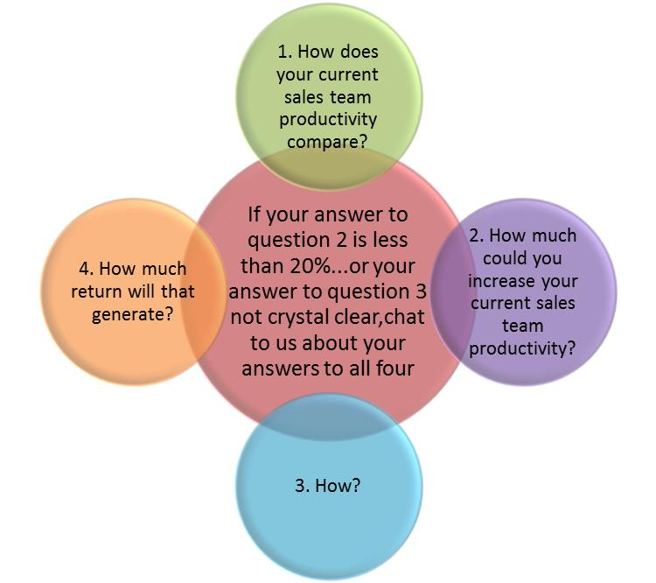
Setting sales team optimisation targets and direction

Slide 12
Eight productivity “levers” to increase RoI

Slide 13
Benchmark current Sales team productivity indicators

Slide 14
Sales team productivity targets

Slide 15
Sales team productivity and return targets

Slide 16
Sales team optimisation strategic direction

Slide 17
Moving to The Next Level

Slide 18
Renew sales strategy

Slide 19
Renewing sales strategy
Review current channels to market and value chain segmentation
  Who are the customers?
  Who are “significant stakeholders”?
  Why?
Review current sales team alignment to chains, channels, segments
  Who do we deploy to?
  How much resource?
  Why?

Slide 20
Go-to-Market strategy relies on making best choices re what to sell, via whom, to whom

Slide 21
Go-to-Market strategy review starts with identifying what to sell, to whom
Specific product group
End product at final use, consumption, ownership

Slide 22
Go-to-Market strategy starts with understanding all players and how (much) they add value
Suppliers
Intermediaries
Makers
End users
Intermediaries
Specific product group
End product at final use, consumption, ownership

Slide 23
What does adding value really mean?
Suppliers
Intermediaries
Makers
End users
Intermediaries
Specific product group
End product at final use, consumption, ownership

Slide 24
What does adding value really mean?
Suppliers
Intermediaries
Makers
End users
Intermediaries
Specific product group
End product at final use, consumption, ownership
A segment player needs to be acknowledged in the chain if they…

Slide 25
What does adding value really mean?
Suppliers
Intermediaries
Makers
End users
Intermediaries
Specific product group
End product at final use, consumption, ownership
A segment player needs to be acknowledged in the chain if they
*modify the product/service on the way through
*move it from one player to another
*reconfigure it
*provide IP for another player

Slide 26
What does adding value really mean?
Suppliers
Intermediaries
Makers
End users
Intermediaries
Specific product group
End product at final use, consumption, ownership
A segment player needs to be acknowledged in the chain if they
*modify the product/service on the way through
*move it from one player to another
*reconfigure it
*provide IP for another player
…in such a way as it adds to the evolving form of the incoming
product/service towards its final state form

Slide 27
What does adding value really mean?
Suppliers
Intermediaries
Makers
End users
Intermediaries
Specific product group
End product at final use, consumption, ownership
…in such a way as it adds to the evolving form of the incoming
product/service towards its final state form
…and the end customer will either pay for value added or buy more for costs saved

Slide 28

To determine Value Chain structure and strategy, define end user/product from your perspective
End product at final use, consumption, ownership
Specific product group
End user at final use, consumption, ownership

Slide 29
Value Chain structure model….. for each end user – end product
Defined in terms
of where “focus player’s”
product/service is consumed
(in its visible form) or finally
changes ownership

Slide 30
Value Chain structure model….. for each end user – end product
Buyers
Non-buyers
End users
Wholesalers
Value adders
Distributors
B2B
consumers
Defined in terms
of where “focus player’s”
product/service is consumed
(in its visible form) or finally
changes ownership
Suppliers
Makers
Installers
Value
adders
B2P
consumers
Specifiers
Resellers/ brokers
Retailers

Slide 31
Value chain structure and distribution channels
Suppliers
Makers
Distributors
B2B consumer
Clearly defined in terms
of where “focus player’s”
product/service is consumed (visible form)

Slide 32
Value chain structure and distribution channels
Suppliers
Makers
Distributors
B2B consumer
Suppliers
Makers
Distributors
B2P consumer
Retailers - vets
Clearly defined in terms
of where “focus player’s”
product/service is consumed (visible form)

Slide 33
Value chain structure and distribution channels
Suppliers
Makers
Distributors
B2B consumer
Suppliers
Makers
Distributors
B2P consumer
Retailers - vets
Clearly defined in terms
of where “focus player’s”
product/service is consumed (visible form)
Retailers – pet stores

Slide 34
Define Value Chain structure ….. for one end user – end product
Buyers
Non-buyers
End users
Wholesalers
Value adders
Distributors
B2B
consumers
Defined in terms
of where “focus player’s”
product/service is consumed
(in its visible form) or finally
changes ownership
Suppliers
Makers
Installers
Value
adders
B2P
consumers
Specifiers
Resellers/ brokers
Retailers

Slide 35
Having defined the end user / end product(s)
End product at final use, consumption, ownership
Specific product group
End user at final use, consumption, ownership

Slide 36
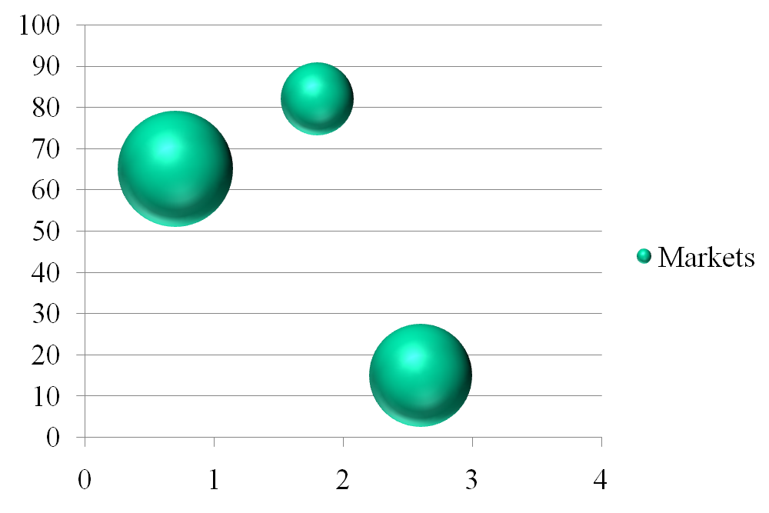
Scope the size, trends and detail the competitive landscape of each market

Slide 37
Go-to-Market strategy relies on making best bets re what to sell, via whom, to whom, vs whom
Suppliers
Intermediaries
Makers
End users
Intermediaries
Specific product group
End product at final use, consumption, ownership

Slide 38
Best bets become complex as increasing competition encourages vertical integration
Suppliers
Intermediaries
Makers
End users
Intermediaries
Specific product group
End product at final use, consumption, ownership

Slide 39
Scoping the competitive landscape includes assessing whether customers are also competitors

Slide 40
Chains, channels, markets clarity leads to meaningful review of Sales team alignment
Underground construction
division
*Tunnelling
*Mining
Civil & tunnelling
Mining
Admixtures
division
Pre-mix concrete
Pre-cast concrete
Manufactured concrete products
Cement production
Property development
Construction
systems
division
Concrete repair
Water proofing
Property development
Grouting
Tiling
Flooring

Slide 41
Sales team alignment means best bets re what to sell, via whom, to whom, vs whom, with whom
Suppliers
Intermediaries
Makers
End users
Intermediaries
Specific product group
End product at final use, consumption, ownership

Slide 42
Who are the customers … who else should be customers
Buyers
Non-buyers
End users
Wholesalers
Value adders
Distributors
B2B
consumers
Defined in terms
of where “focus player’s”
product/service is consumed
(in its visible form) or finally
changes ownership
Suppliers
Makers
Installers
Value
adders
B2P
consumers
Specifiers
Resellers/ brokers
Retailers

Slide 43
….how do we exert optimal sales control
Buyers
Non-buyers
End users
Wholesalers
Value adders
Distributors
B2B
consumers
Defined in terms
of where “focus player’s”
product/service is consumed
(in its visible form) or finally
changes ownership
Suppliers
Makers
Installers
Value
adders
B2P
consumers
Specifiers
Resellers/ brokers
Retailers

Slide 44
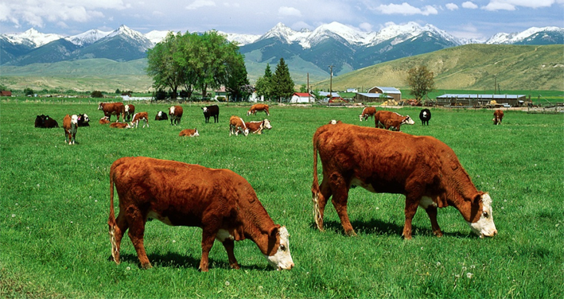
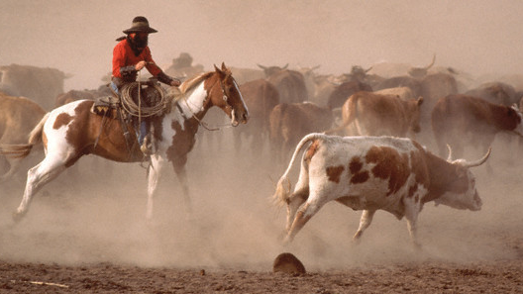
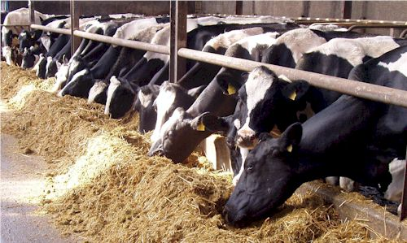

Slide 45

Servicing-Farming-Hunting-Specifying spectrum
SERVICING
Ensure current customer orders are fulfilled
FARMING
Retain and grow existing customers
HUNTING
Win new customers
SPECIFYING
Solicit advocacy from non-buyers to buyers

Slide 46
Salesteam strategy
Push sales strategy = sales exec visits customer
to sell direct

Slide 47
Salesteam strategy
Push sales strategy = sales exec visits customer
to sell direct
Pull sales strategy = sales exec visits customer to sell indirect
ie to influence customer buying behaviour
when buying through their preferred intermediary

Slide 48
Salesteam strategy
Push sales strategy = sales exec visits customer
to sell direct
Pull sales strategy = sales exec visits customer to sell indirect
ie to influence customer buying behaviour
when buying through their preferred intermediary
Specifying sales strategy = sales exec visits intermediary or end customer who directs other customer segment to buy a specific product/service
ie influence advocacy behaviour.....”specify the specifier”

