Slide 1
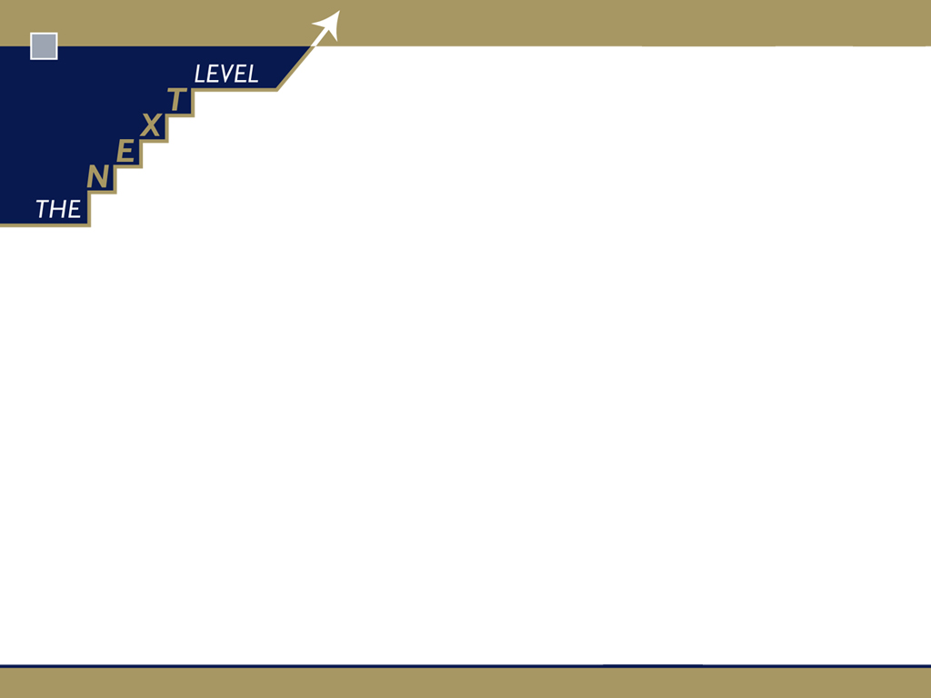
Upgrade your selling systems
The qualitative part
Glenn Guilfoyle

Slide 2
The Next Level …. What we do and how we do it
Specialise in deploying proprietary Sales System to any B2B organisation
  model,
  map,
  design,
  plan,
  measure maximum sales team productivity and RoI
Work collaboratively, transferring tools, skills and knowledge to our clients

Slide 3
The Next Level Sales System
Sales team optimisation and Sales exec effectiveness system
  tailored for any business-to-business sales organisation
End-to-end suite of modellers, designers, mappers
  review, challenge, renew salesteam utilisation, strategy, benchmarks
    optimise sales process, system, team performance

Slide 4
What is Sales team optimisation? (StO)

Slide 5
40,000 B2B Sales organisations
At least “a handful of road warriors”
Large, heterogeneous collection of customers and prospects
Repeat visits to align with repeat order consumable products or services
Customers have multiple and easily switchable supplier choice

Slide 6
40,000 B2B Sales organisations are sub-optimised
At least “a handful of road warriors”
Large, heterogeneous collection of customers and prospects
Repeat visits to align with repeat order consumable products or services
Customer has switchable supplier choice

Slide 7
What is Sales team optimisation? (StO)
Analytics that align Sales team design and process with classification of customer base and profiling of prospect pool
  Maximum productivity and RoI from resource available
Science of engineering a sales team to a tailored system
  Mobilise resource to best utilisation for maximum realisation

Slide 8
What is Sales team optimisation? (StO)
Right person
Right time
Right frequency
Right reason
Right value
Right partnership framework

Slide 9
Problem solved
Failure to deliver maximum revenue/margin
From under-productivity
Due to lack of sales system

Slide 10
Problem solved … BUT …
Failure to deliver maximum revenue/margin
From under-productivity
Due to lack of sales system

Slide 11

But … optimise what? … challenge first

Slide 12
The context for many Oz B2B sales orgs
The mature market that has not been disrupted … yet
Relative lack of innovation and consequent commoditisation
Increasing (global) competition
The rise of e-commerce and the educated customer
The race to the bottom
Trends to market consolidation and centralisation
Difficulty in assessing Sales exec productivity and effectiveness
Pressure on justification of expense and RoI of sales team

Slide 13
The decline of relationship selling
Conventional wisdom = relationship underpins sales success
Decoupling of relationship and purchasing decision

Slide 14
The rise of challenger selling
Offers unique perspectives
Strong two-way communication skills
Knows customer value drivers
Identify economic drivers
Comfortable discussing money
Can pressure the customer

Slide 15





The Challenger Sale

Slide 16
Challenger selling key features
Teach
Tailor
Take control

Slide 17
Challenger selling key features
Teach
  Deliver insights that help reframe and see differently
    Teach how to compete better
Tailor
  Contextualise sales messages
Take control
  Leverage constructive tension over all dimensions

Slide 18
Teaching the customer what they don’t know but should
Offer unique, valuable perspectives on the market
Help navigate alternatives
Provide ongoing advice or consultation
Help avoid potential land mines
Educate on new issues and outcomes

Slide 19
Not just any teaching …. Commercial teaching
Lead to your unique strengths
Challenge customer assumptions
Catalyze actions
Scaled by sales organisation … and across customers

Slide 20
Commercial teaching model
Your solution
FABs linked back
positive
Reframe
Unrecognised need, problem, assumption
Value proposition
A new way
Warmer
Build credibility; demonstrate empathy
Emotional impact
Humanise problem
neutral
Drowning
Intensify problem – degree & closeness
negative
intrigued
drowning
involved
relieved

Slide 21



Converting sales relationships to business partnerships

Slide 22
The missing piece
Your solution
FABs linked back
positive
Reframe
Unrecognised need, problem, assumption
Value proposition
A new way
Warmer
Build credibility; demonstrate empathy
Emotional impact
Humanise problem
neutral
Drowning
Intensify problem – degree & closeness
negative
intrigued
drowning
involved
relieved

Slide 23
The reality for many of us in mature market, B2B sales orgs
Innovation capability is quite low
Cheaper overseas competition is on the rise
Threat of disruption ever present
Perceived commoditisation reins supreme

Slide 24
The great irony in the way we react
Perceived discretionary costs come into focus
Cost of mobilisation comes under crutiny
Headcount becomes a “lifeline”
Sometimes the sales team is considered part of the root cause

Slide 25
The great irony in the way we react
Perceived discretionary costs come into focus
Cost of mobilisation comes under scrutiny
Headcount becomes a “lifeline”
Some times the sales team is considered part of the root cause
wrong

Slide 26
The sales team should be the surrogate for absent product/service differentiation

Slide 27
Go back to the future
David Maister’s classic
Put your organisation to the brutal “come to Jesus” chat
Re-engineer the sales team if you cannot innovate the product service for differentiation
  “the trusted advisor”

Slide 28
How?
Enmesh the Sales Exec with the customer …
  be first
Ensure the new role design gives the “unfair advantage”

Slide 29
How?
Imagine

Slide 30
Keh?
Are we now telling
Sales teams to stop
Selling???

Slide 31
The entirely different customer conversation

Slide 32
Be the trusted partner first … then perform sales and service

Slide 33
To what extent is your sales and service part of your trusted partner model?

Slide 34
The entirely different on-going customer conversation
Quid pro quo

Slide 35
The quid pro quo for sustainably increased loyalty and RoI?
Written into your preferred supplier agreements … off-setting / deflecting from price / rate review focus
Elevate the Sales Exec to program director and consequently provides the “unfair advantage”

Slide 36
Systemitise your challenge
Don’t leave this to individual Sales Execs
More sales and/or product-application is the last thing Sales Execs need and customers want
“the trusted advisor”

